Slide 1

Optimal Control Methodology for Energy Balancing in Microgrids
23AID305-Control Systems
Team B-1

Slide 2

Team Members
Sandeep Srr CB.AI.U4AID23140
SivaSai Kumar CB.AI.U4AID23156
Mahadev Naidu CB.AI.U4AID23111
Manoj Kumar CB.AI.U4AID23161

Slide 3
Contents
Introduction
Literature Review
Research Gaps
Problem Statement
Objectives
Block Diagram / Flowchart
Methodology
Results & Discussion
Conclusion & Future Scope
References

Slide 4
INTRODUCTION
A grid is a large-scale centralized electricity network that transmits power from generators to consumers over long distances.
A microgrid is a localized energy system that can operate independently or in conjunction with the main grid, integrating distributed energy sources like solar, wind, and batteries.
A smart grid incorporates digital technology and automation to monitor, manage, and optimize the flow of electricity within both traditional grids and microgrids.
Unlike traditional grids, microgrids are more flexible and resilient, and smart grids enable real-time control, better reliability, and energy efficiency
Integration of renewable energy introduces variability and instability in power systems.
Notes:
Faraday’s Law: A changing magnetic field through a loop induces an electromotive force (EMF) in it.
This is how voltage is generated in the stator. When the north pole of the magnet passes the stator coil, the induced voltage is positive.
When the south pole passes, the magnetic field direction reverses, so the voltage is negative.

Slide 5
Literature Review
S.NO | Title & Author | Key Insight
1. | GWCSO-based EMS | Grey wolf crow search used for EMS in RES-based microgrids. Focused on sizing/optimization. Limitation: No real-time control or price-feedback.
2. | Hybrid GA-PSO EMS | GA and PSO for hybrid microgrid energy optimization under uncertainty. Limitation: No feedback-based demand control.
3. | MILP for energy cost reduction | MILP model applied to minimize operational costs in microgrid dispatch. Limitation: Not real-time; static assumptions.
Notes:
Multi-agent Physics-informed DDPG (PAMA-DDPG) wake and battery degradation models Deep Deterministic Policy Gradient
Wake and battery degradation models
Double DQN(Double Deep Q-Network), virtual inertia/droop control(A primary control mechanism used in power systems to share load among parallel generators or inverters. It defines a proportional relationship between frequency deviation and power output change), fuzzy logic for BESS, DC transmission optimization
State reconstruction, coordinated control, economic optimization
Primary frequency modulation, quantitative inertia modeling, droop control multi-source coordination
Virtual Inertia: Renewable energy sources (like wind and solar) connected via power electronics often lack inherent inertia. Virtual inertia control involves programming inverters of BESS or renewable generators to mimic the behavior of synchronous generators, injecting or absorbing power to counteract frequency deviations, thus providing synthetic inertia to the grid
Quantitative inertia modeling: Goes beyond simply saying "there is inertia." This involves developing precise mathematical models to quantify the amount of inertia present in different parts of the grid, including the effective inertia provided by synchronous machines and the synthetic inertia provided by power electronics-interfaced resources like BESS. Accurate quantitative models are essential for designing effective frequency control strategies and assessing system stability.

Slide 6
Literature Review
S.NO | Title & Author | Key Insight
4. | Gravitational + PSO MOO | Solved emission-cost trade-off in dispatch using multi-objective optimization. Limitation: No demand-side elasticity integration.
5. | EV charging via MAS | EV demand forecast using agents (SOC, weather, traffic). Limitation: Forecasting-only; no microgrid control..
6. | Classical PI for DR | PI control for price-based demand response. Limitation: Slow response; overshoots in dynamic systems..
Notes:
Multi-agent Physics-informed DDPG (PAMA-DDPG) wake and battery degradation models Deep Deterministic Policy Gradient
Wake and battery degradation models
Double DQN(Double Deep Q-Network), virtual inertia/droop control(A primary control mechanism used in power systems to share load among parallel generators or inverters. It defines a proportional relationship between frequency deviation and power output change), fuzzy logic for BESS, DC transmission optimization
State reconstruction, coordinated control, economic optimization
Primary frequency modulation, quantitative inertia modeling, droop control multi-source coordination
Virtual Inertia: Renewable energy sources (like wind and solar) connected via power electronics often lack inherent inertia. Virtual inertia control involves programming inverters of BESS or renewable generators to mimic the behavior of synchronous generators, injecting or absorbing power to counteract frequency deviations, thus providing synthetic inertia to the grid
Quantitative inertia modeling: Goes beyond simply saying "there is inertia." This involves developing precise mathematical models to quantify the amount of inertia present in different parts of the grid, including the effective inertia provided by synchronous machines and the synthetic inertia provided by power electronics-interfaced resources like BESS. Accurate quantitative models are essential for designing effective frequency control strategies and assessing system stability.

Slide 7
Literature Review
S.No | Title & Author | Key Insight
7. | FOPI Controller | Fractional-order PI improves flexibility in dynamic pricing. Limitation: Complex and lacks realtime adaptability.
8. | WOA-optimized FOPI | Whale Optimization tuned FOPI in multi-source grids. Limitation: Good for frequency control, but no real-time price-feedback.
Notes:
Multi-agent Physics-informed DDPG (PAMA-DDPG) wake and battery degradation models Deep Deterministic Policy Gradient
Wake and battery degradation models
Double DQN(Double Deep Q-Network), virtual inertia/droop control(A primary control mechanism used in power systems to share load among parallel generators or inverters. It defines a proportional relationship between frequency deviation and power output change), fuzzy logic for BESS, DC transmission optimization
State reconstruction, coordinated control, economic optimization
Primary frequency modulation, quantitative inertia modeling, droop control multi-source coordination
Virtual Inertia: Renewable energy sources (like wind and solar) connected via power electronics often lack inherent inertia. Virtual inertia control involves programming inverters of BESS or renewable generators to mimic the behavior of synchronous generators, injecting or absorbing power to counteract frequency deviations, thus providing synthetic inertia to the grid
Quantitative inertia modeling: Goes beyond simply saying "there is inertia." This involves developing precise mathematical models to quantify the amount of inertia present in different parts of the grid, including the effective inertia provided by synchronous machines and the synthetic inertia provided by power electronics-interfaced resources like BESS. Accurate quantitative models are essential for designing effective frequency control strategies and assessing system stability.

Slide 8
Research Gaps
Traditional PI/FOPI controllers lack adaptability under nonlinear renewable and load dynamics.
Sliding Mode Control suffers from chattering; STSMC is rarely applied in real-time energy pricing.
ACO remains underutilized for tuning nonlinear controllers like STSMC in microgrid applications.
Dynamic pricing is often static; few studies link it with control-driven demand response.
Limited work exists on adaptive, Simulink-based frameworks integrating control and optimization.

Slide 9
Project Objective
To Develop a closed-loop system to maintain supply-demand balance in a microgrid.
To Regulate consumer demand dynamically using price as a control signal.
To Optimize controller parameters using a metaheuristic algorithm.

Slide 10
Problem Statement
The integration of renewable energy sources like solar and wind into microgrids increases variability and unpredictability in power generation.
Consumer demand changes dynamically, adding further complexity to the system.
These factors make real-time energy balancing a major challenge.
Traditional control methods often lack the robustness and adaptability required to handle such nonlinear and uncertain environments.

Slide 11
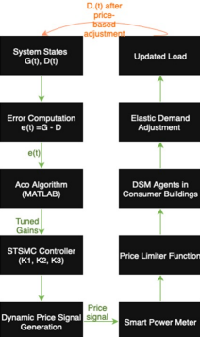
Workflow Overview

Slide 12
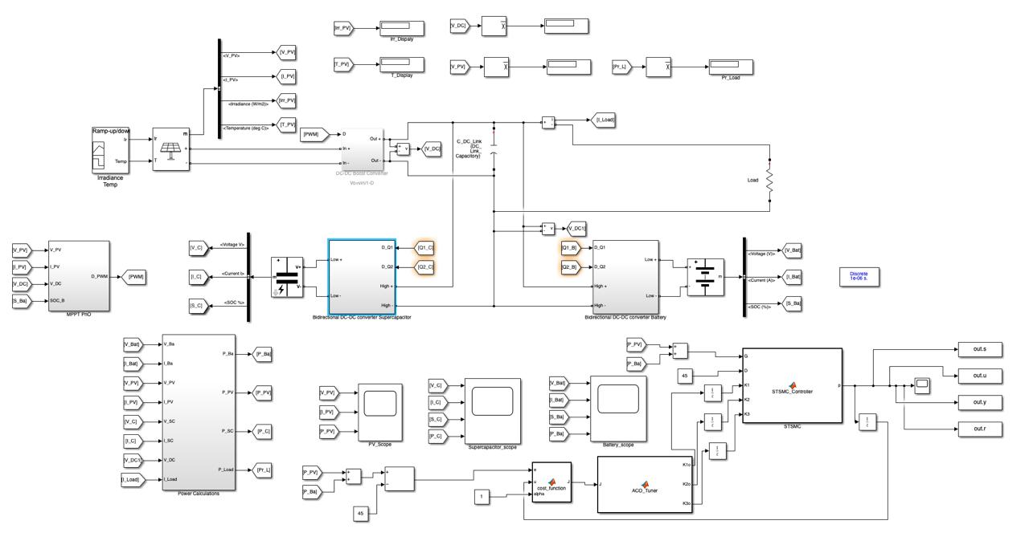

Slide 13
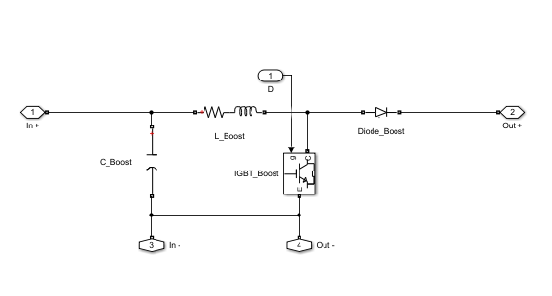
ste
Sub system for DC-DC Boost Converter
Notes:
Ramp Time is the total amount of time you want to spend gently reducing your help after an emergency is over (like counting down from 300 seconds).
Ramp Timer is like an egg timer that counts down how much longer you should keep relaxing your help.

Slide 14
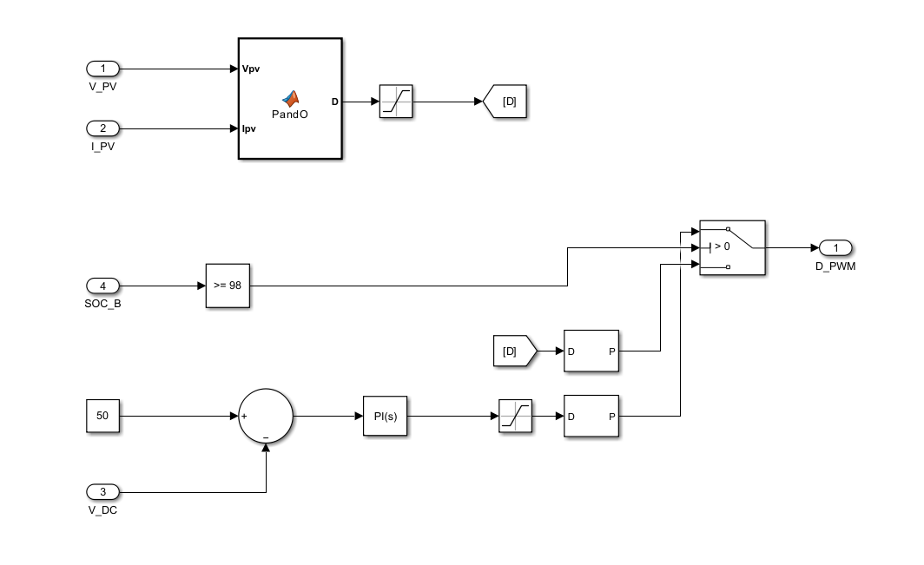
Sub system for MPPT Pno
Notes:
Ramp Time is the total amount of time you want to spend gently reducing your help after an emergency is over (like counting down from 300 seconds).
Ramp Timer is like an egg timer that counts down how much longer you should keep relaxing your help.

Slide 15
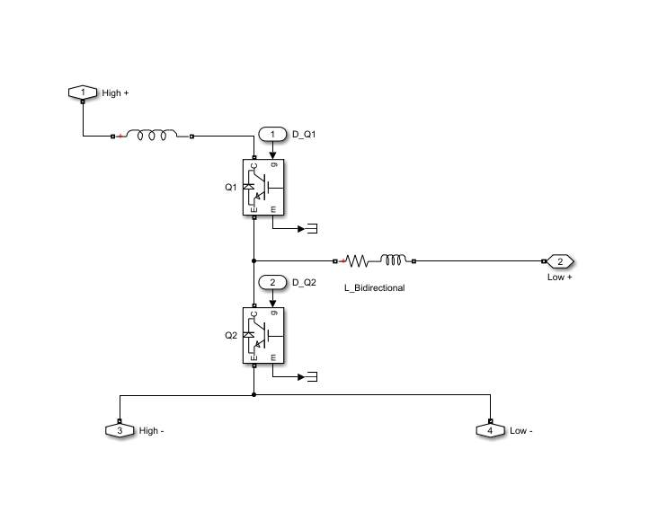
Sub system for Bidirectional DC-DC Converter Supercapacitor
Notes:
Ramp Time is the total amount of time you want to spend gently reducing your help after an emergency is over (like counting down from 300 seconds).
Ramp Timer is like an egg timer that counts down how much longer you should keep relaxing your help.

Slide 16
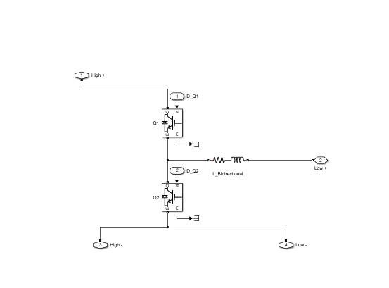
Sub system for Bidirectional DC-DC Converter Battery
Notes:
Ramp Time is the total amount of time you want to spend gently reducing your help after an emergency is over (like counting down from 300 seconds).
Ramp Timer is like an egg timer that counts down how much longer you should keep relaxing your help.

Slide 17
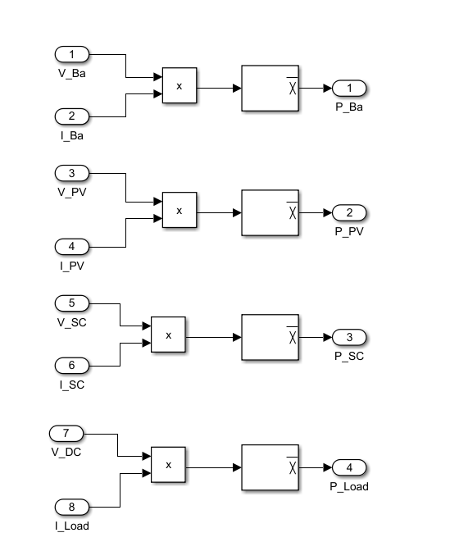
Sub system for power calculations

Slide 18
Methodology Overview
Integrates renewable source models, energy storage, and price-responsive demand.
Uses a nonlinear controller to generate dynamic pricing signals.
Controller parameters are fine-tuned using Ant Colony Optimization (ACO).
Simulated in MATLAB/Simulink under real-world conditions.

Slide 19
Microgrid System Components
Solar PV and Wind: Provide intermittent renewable generation.
Battery Storage (ESS): Manages surplus and shortages in supply.
Elastic Load: Load varies based on price signals.
Intelligent Controller: Adjusts electricity price in real-time to balance load.

Slide 20
Control Approach
Employ Super-Twisting Sliding Mode Control (STSMC) to manage nonlinear behavior.
Control signal: dynamic price p(t) based on error.
Error signal: e(t) = G(t) − Do(t)
Where G(t) is power generated, Do(t) is optimized demand.

Slide 21
STSMC Control Law (Enhanced)
u(t) = K1e(t) + K2|e(t)| 1/2 sign(e(t)) + K3 sign(e(t))
Purpose: Adjust demand via price signal based on generation-demand mismatch.
Components:
  K1e(t): Linear term to reduce steady-state error.
  K2|e(t)| 1/2 sign(e(t)): Fast convergence term.
  K3sign(e(t)): Disturbance rejection term.
Super-twisting logic reduces chattering vs traditional SMC.
Ensures robust, finite-time convergence even under uncertainty.

Slide 22

ACO-Based Optimization
ACO optimizes controller gains K1,K2,K3 to minimize error and price fluctuation.
Fitness function
Emulates ant behavior to find optimal control paths via pheromone trails. Provides a global search mechanism resistant to local minima..

Slide 23
RESULTS

Slide 24
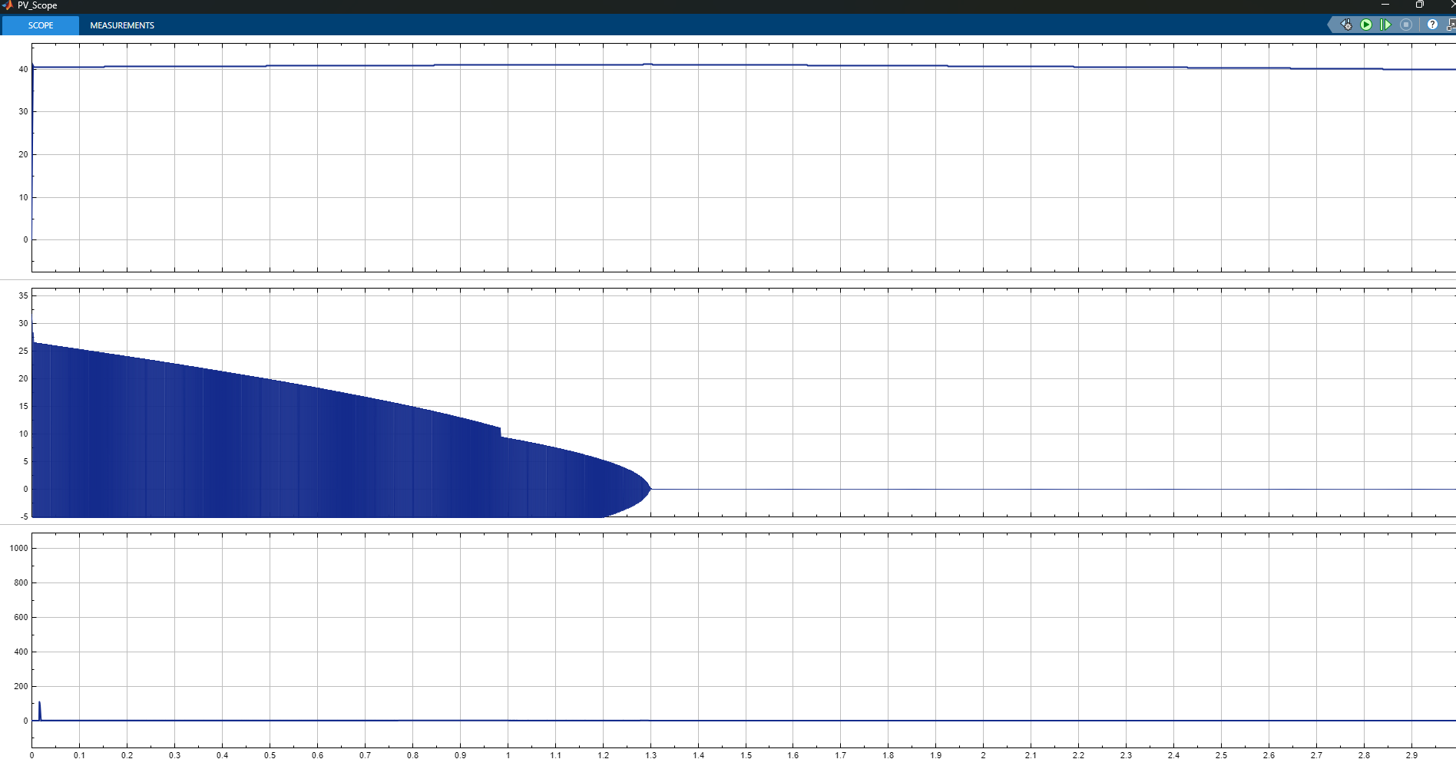
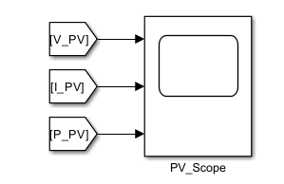
PV ARRAY

Slide 25
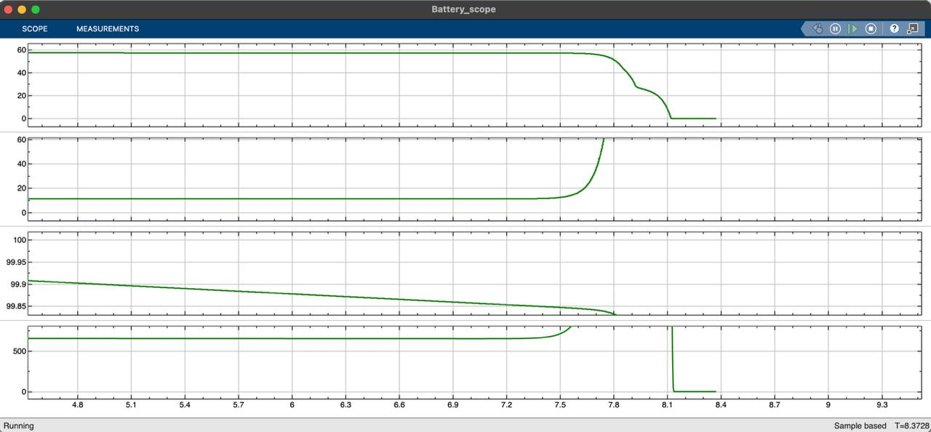
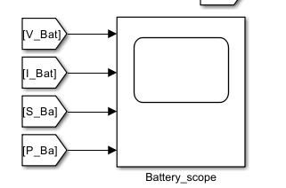
BATTERY

Slide 26
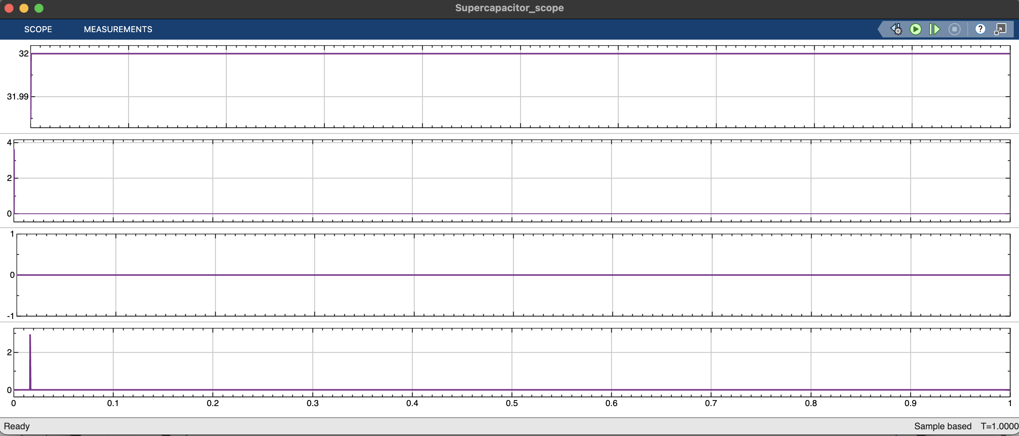
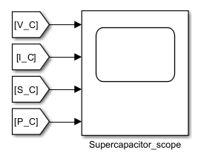
Supercapacitor

Slide 27
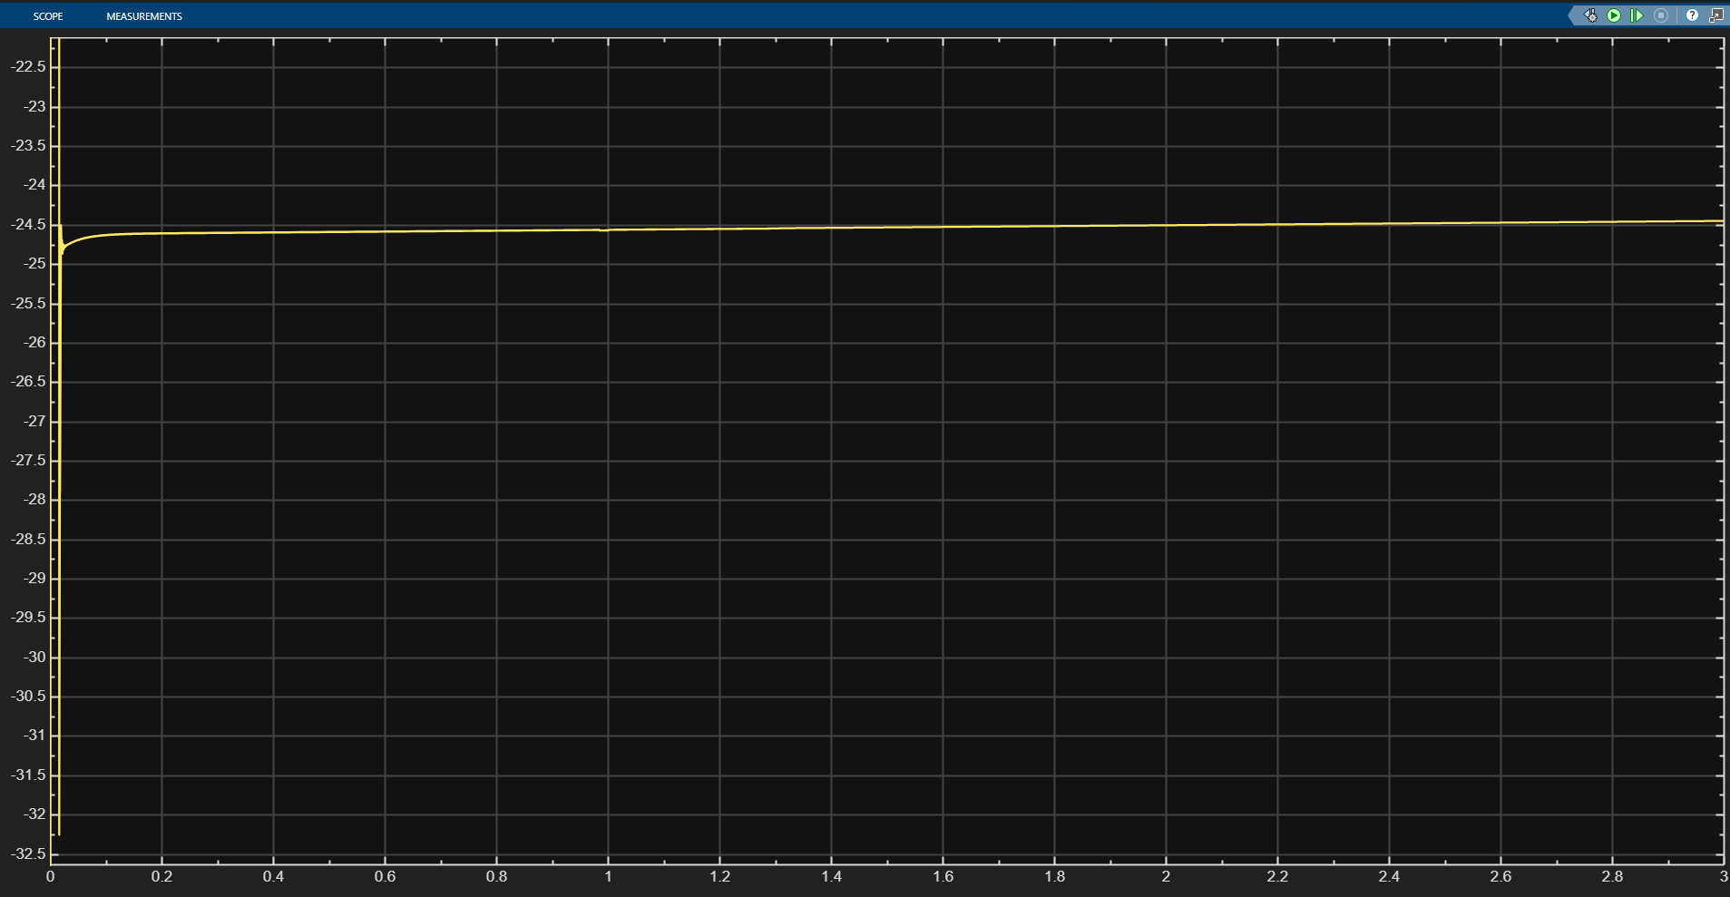
STSMC

Slide 28
Conclusion
Developed a microgrid simulation with high renewable penetration and dynamic load conditions.
Implemented STSMC (Super-Twisting Sliding Mode Control) for robust control under nonlinear and uncertain conditions.
Used ACO (Ant Colony Optimization) to automatically tune controller parameters, reducing manual effort and improving performance.
Achieved fast convergence of tracking errors and significantly reduced chattering compared to traditional sliding mode control.

